Slide 1
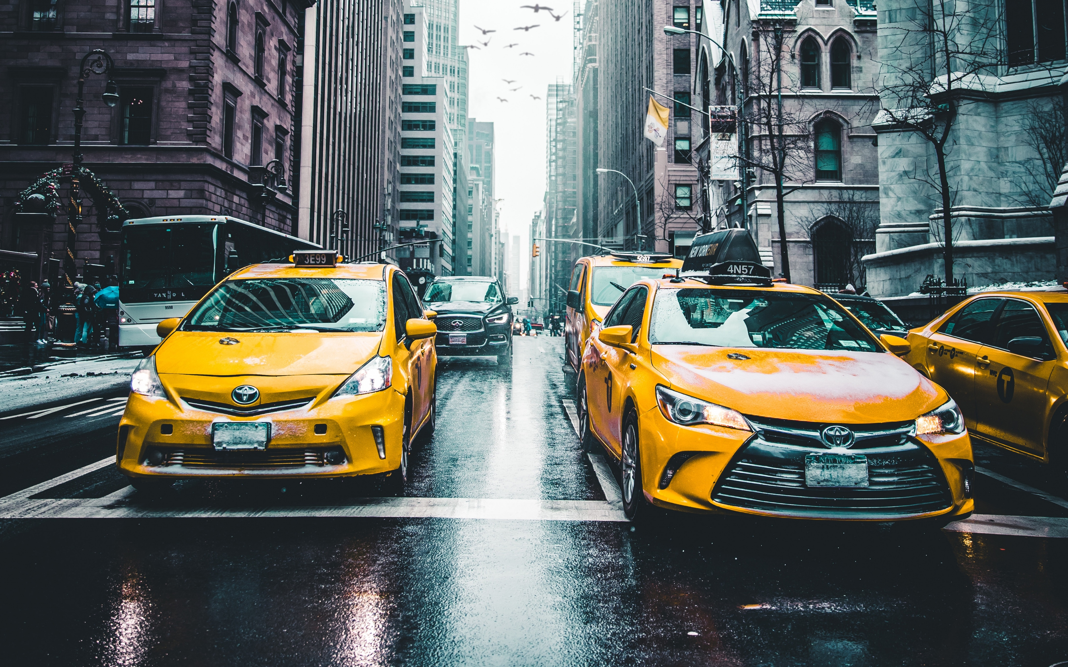
Yellow Taxi Challenge

Slide 2
01
DATA CONTEXT AND UNDERSTANDING
02
DATA CLEANING AND PREPARATION
03
DESCRIPTIVE ANALYSIS
04
BOKEH APP ANALYSIS
05
DISCUSSION

Slide 3
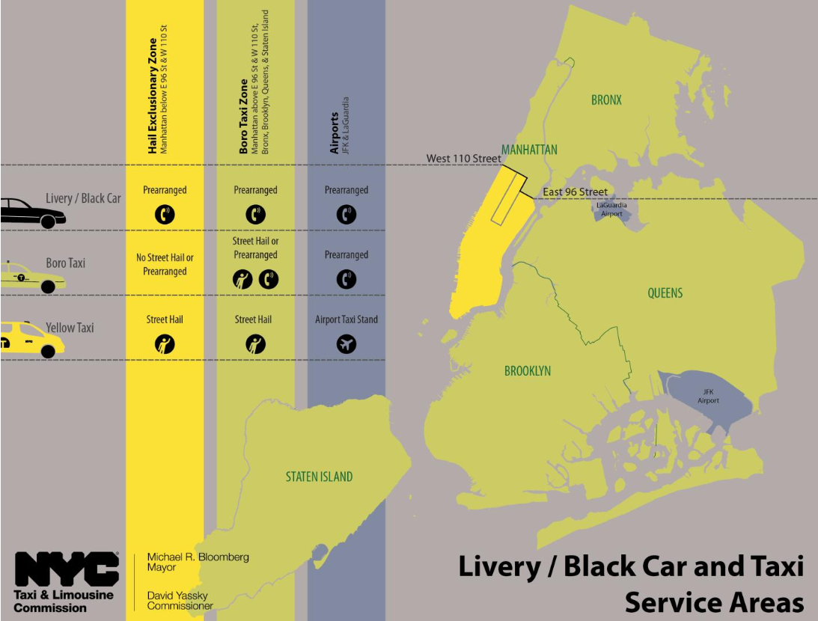
Data Context
Yellow taxis have an exclusive hail zone in Manhattan and at the airports.
By law, there are 13,587 yellow taxis (medaillons) in New York City.
Drivers lease a vehicle for about $150 per shift (10-12 hours)
Driver collects 100% of the fares and tips, all expenses are on them.
Taxis are often shared to increase their time on the road.
The 2 TPEP providers calculate the standard tip rate differently.

Slide 4
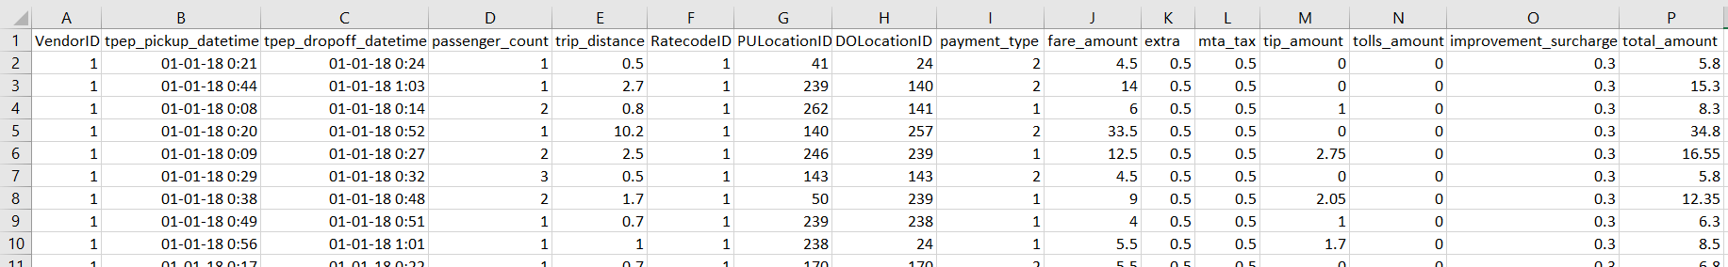
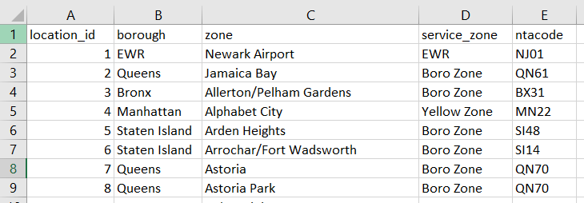
Data understanding
STRUCTURE
new_york_taxi.csv
taxi_zones.csv

Slide 5
Data understanding
CHARACTERISTICS AND LIMITATIONS
Data ranges from 1st to 3rd of January 2018 (Monday until Wednesday)
Implications:
New Year’s day might show significantly different characteristics
Small data range (not even full week) makes it hard to do predictions outside of this time frame
Only separate taxi rides (no information about driver or taxi number)
Implications:
No insight in usual taxi journey (waiting times, distances without passengers, amount of rides per day)

Slide 6
DATA understanding
PROBLEM STATEMENT
Objective: “Maximize the taxi driver’s gains and/or quality of life”
Decide when to drive (which hours of the day)
Decide where to drive
Maximize chance of pickups
Maximize expected tip rate

Slide 7
Data cleaning & preparation
VARIABLE ENGINEERING
Pickup hour & day
Trip time
Trip speed
Income
Tip rate
Airport
PM
New year dummy

Slide 8

Data cleaning & preparation
CLEANING
742262
No missing values… hurray!
But negative values Deleted all pairs, because these are mistakes
Total earnings = 0 Deleted, because we want to make money!
No charge or dispute Deleted, because ambiguity of payment type
Passengers = 0 Set to 1, because unimportant characteristic (cf. infra)
Trip distance = 0 Deleted, because often meter error
-820
-114
-5039
-0
-4181

Slide 9
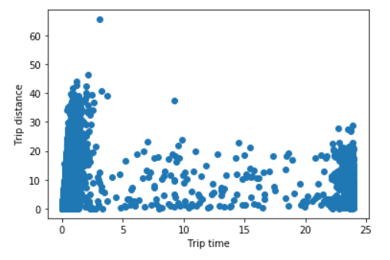
Data cleaning & preparation
CLEANING
Speed > 100 mph Deleted, because unrealistically fast
Trip time <= 0 Deleted
Trip time > 3hrs Deleted, because erroneous data
Final step of preparation: Merge PULocationID and DOLocationID with taxi zones dataset
-1075
-1
-1687
Amount of rides in cleaned dataset:
(96% of initial dataset)
712075

Slide 10
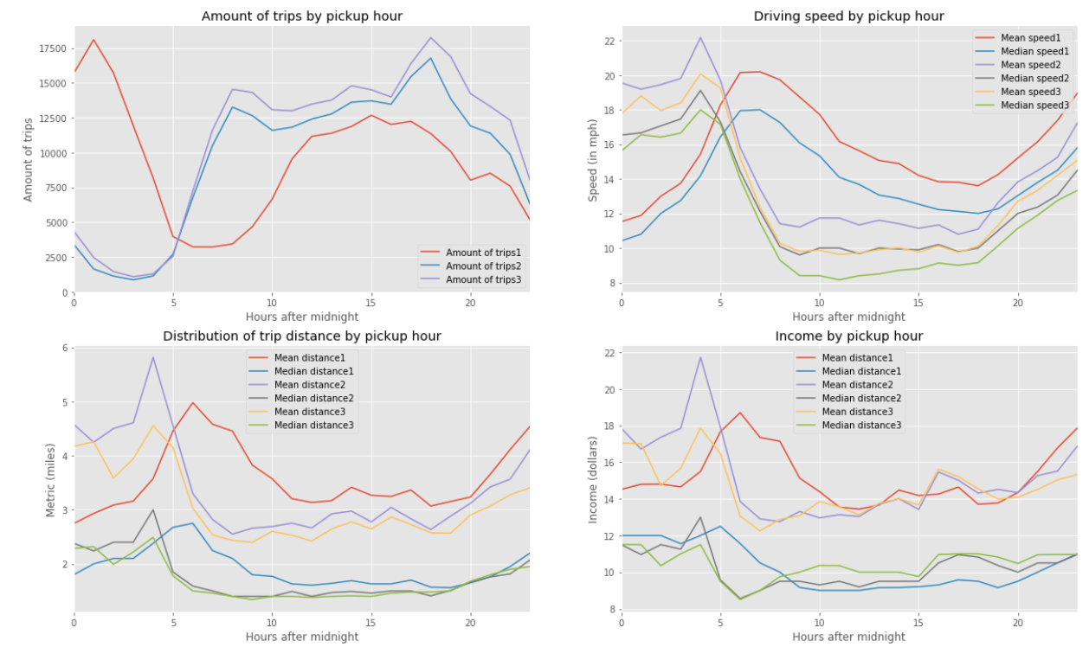
Descriptive analysis
WHEN TO DRIVE
NYE
7:00-20:00
Bad traffic
High income in early hours*
Notes:
Insights:
Clear difference between new year’s day and other days in early hours.
Between 7:00 and 20:00 the most trips are carried out.
Traffic is bad during the same hours
High income in early hours
*i.e. higher distance, higher speed, but no sign of how many taxis are just waiting around

Slide 11
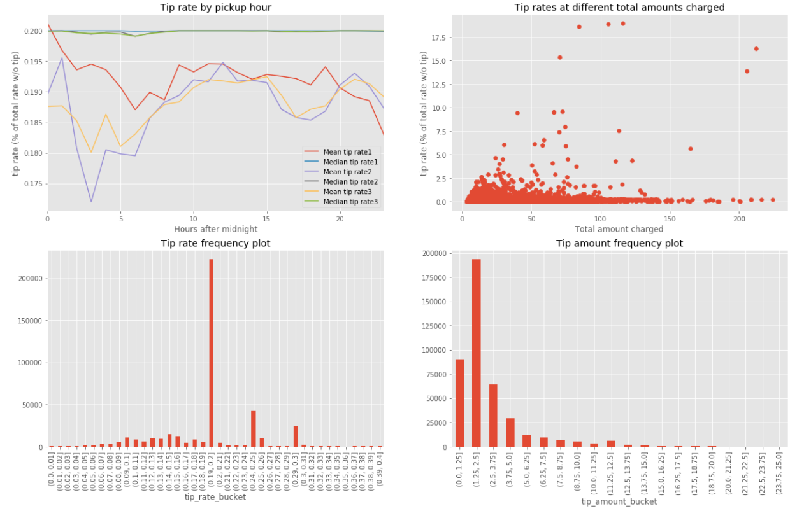
Descriptive analysis
WHEN TO DRIVE
Credit card data
Default settings
Mid-day stability
Short trip attractiveness*
Notes:
Insights:
Only credit card data
20, 25, 30 percent is the default, the median is pinned to 20
Mean tip rate is high and for every day the same during midday (10:00-15:00)
Short cheap rides SEEM to get higher tiprates
*tips are still a small percentage of the total amount charged, one should be cautious about preferring short trips to hunt higher tip rates. Long trips enhance payed driving time as opposed to waiting time.

Slide 12

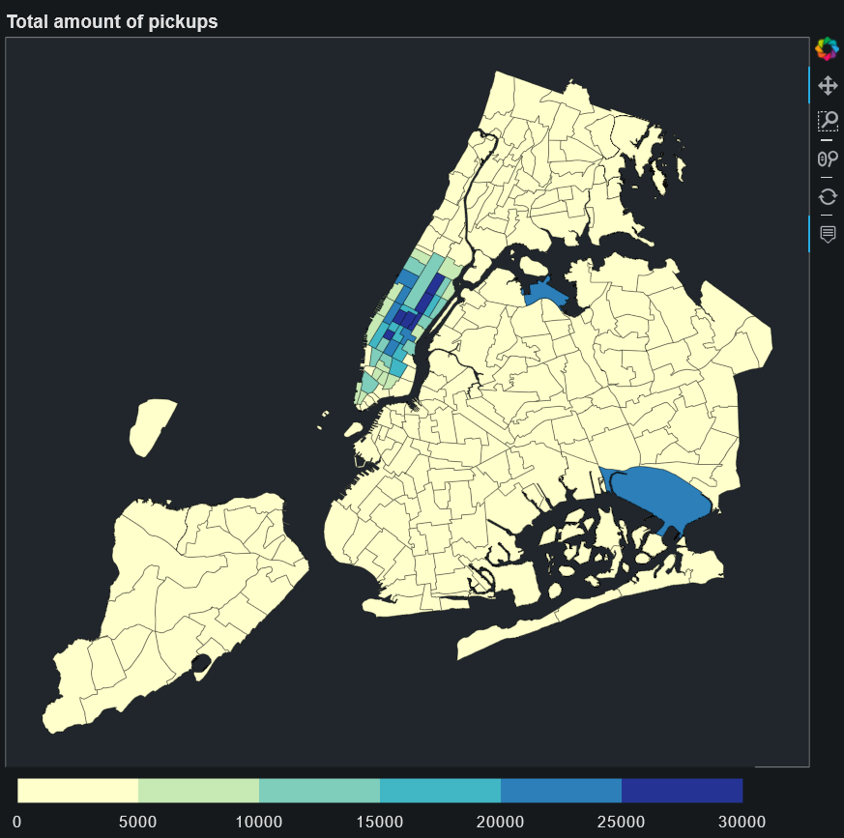
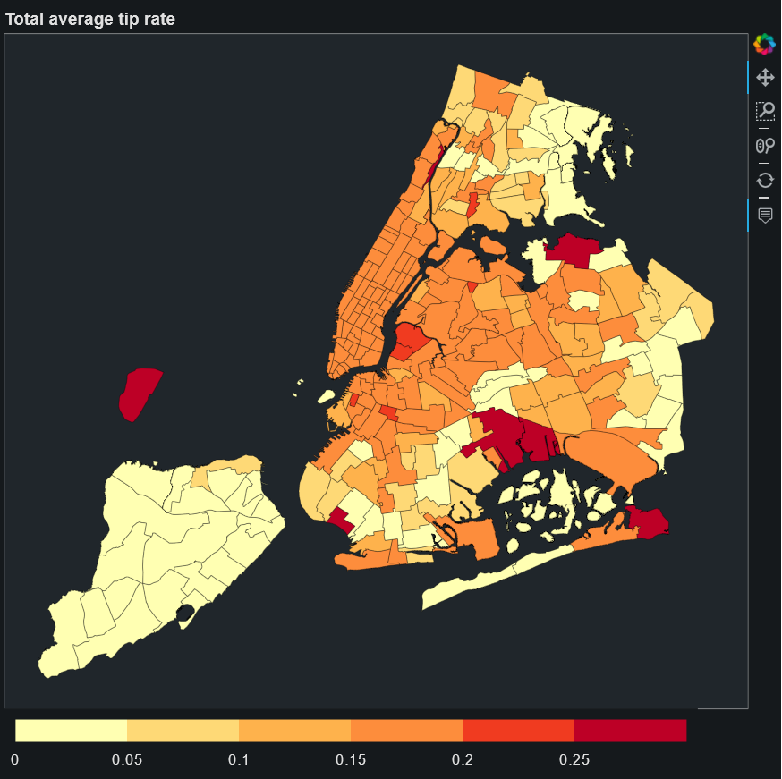
Descriptive analysis
WHERE TO DRIVE

Slide 13
BOKEH APP analysis
WHERE TO DRIVE
General timeline of a regular day:
- 6:00-7:00 Penn. Station is first big concentration
- Big concentrations in Manhatten throughout the day
- 15:00-16:00 Start of big airport traffic
- Afternoons in general: Upper East Side concentration
- 19:00 Midtown Center
- 21:00-22:00 Times Square
- Airports busy until around midnight
-Tip rate averages are similar and seem to vary randomly over time and location
Insights in a new year’s day:
- On NYE, Clinton East and East Village in Manhatten are popular (around 2-3am)
- Pennsylvania station and airports are the main passenger hubs

Slide 14
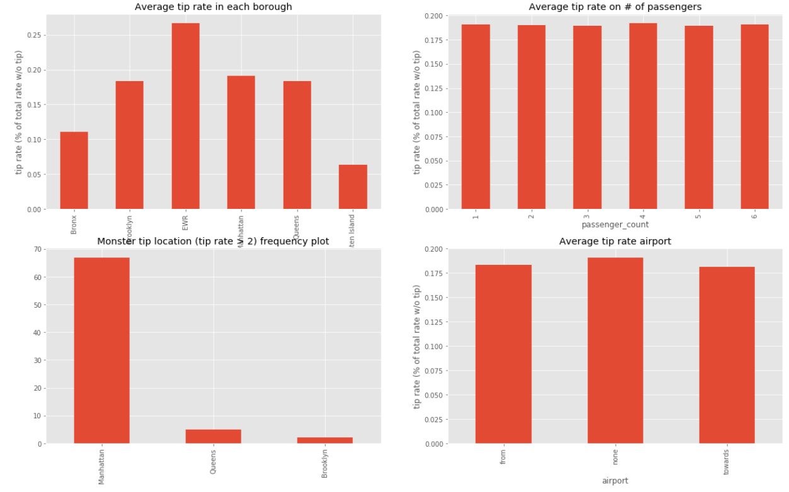
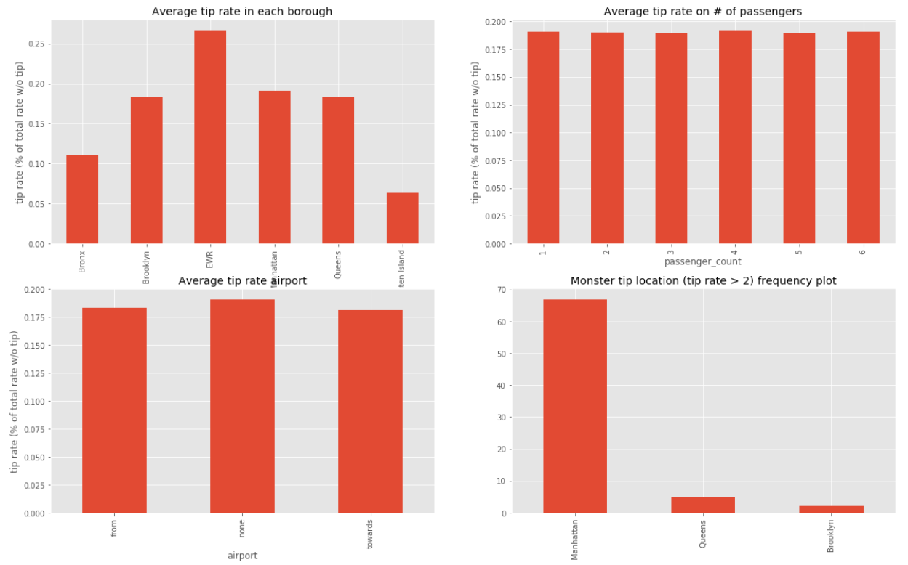
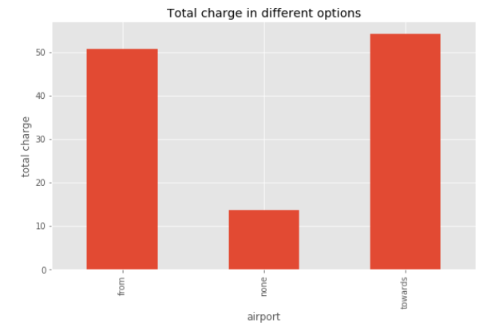
Other features
DESCRIPTIVE
Bronx, Staten Island & EWR
# of passengers don’t matter
Manhatten monster tips
Airport trips = steady income

Slide 15
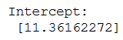
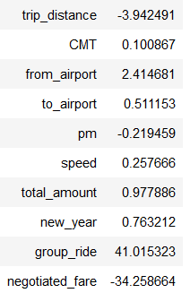
OTHER FEATURES
LINEAR REGRESSION
Distance of a trip has a very negative effect
Coming from the airport has a big positive effect
Group rides have a very positive effect
Negotiated fares are virtually always without tip
New Year’s day has a small positive effect
Meter device (CMT) and speed have a very small effect

Slide 16
discussion
RECOMMENDATIONS
Best time to drive: 7:00 until 20:00
Manhatten, JFK & Laguardia airports are great locations for pickups
Airport rides are a good way to get more payed miles into your shift
Proposed Strategy: Penn. station in the morning, around Central Park (+ airport) in the afternoon, Midtown & Times Square (+ airport) in the evening
Searching new rides? Check the app!

Slide 17
Discussion
WHY’S
Why not engineer a variable attractivity, combining amount of trips and tip rate?
Tip rate result is on a subset (2/3) of total data, importance of number of rides is considerably higher
Why only a linear regression?
More important to assess feature effects than to precisely predict the tip rate
Dependent variables are only known in the process of a ride (speed)
It’s against the law for taxis to discriminate hailers based on destination within New York
Why Bokeh?
Convenient interactive map visualization
Good documentation and examples

